Slide 1

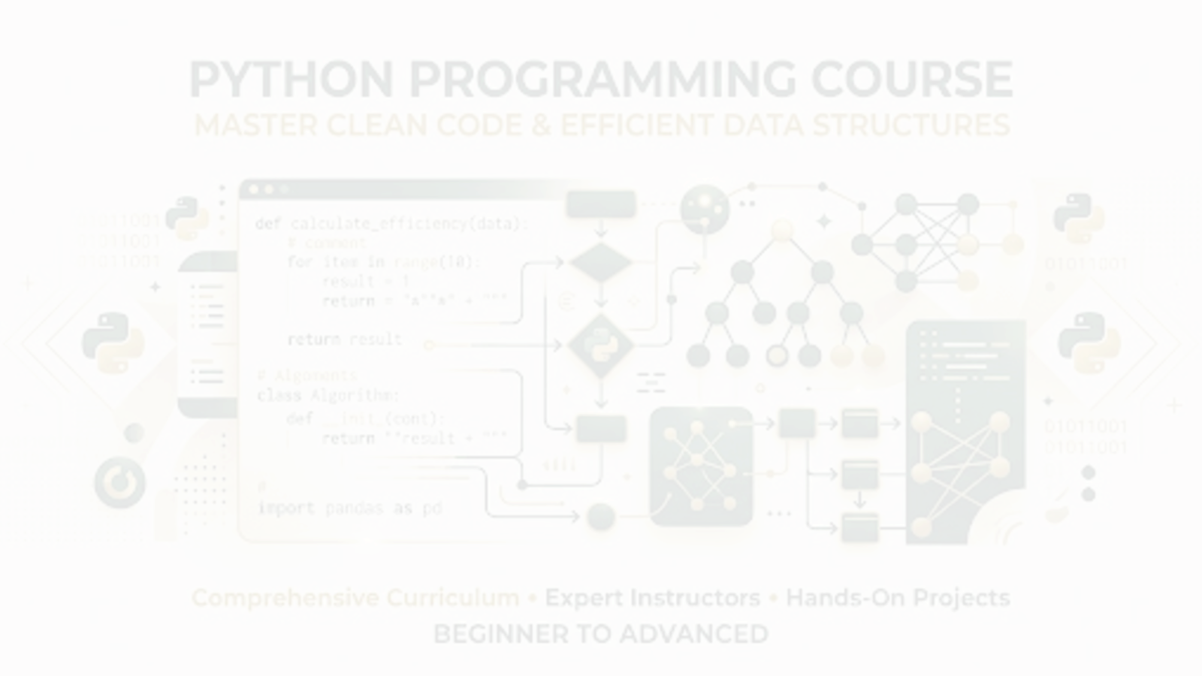


PYTHON PROGRAMMING COURSE
Functions in Python
Building Reusable and Efficient Programs
PRESENTED BY
DATE OF SESSION
Muhammd Yousif Memon
June 2026

Slide 2


Learning Objectives
Mastering the core concepts of Python functions:
Understand what functions are and their primary benefits.
Learn how to create and call user-defined functions.
Master the use of parameters and return values.
Comprehend variable scope (local vs. global).
Explore advanced concepts like lambda functions and recursion.
Apply functions to real-world programming scenarios.
Functions in Python | Building Reusable and Efficient Programs

Slide 3


What is a Function?
DEFINITION
CODE EXAMPLE
A reusable block of code designed to perform a specific task.
def greet():
print("Hello, welcome to Python programming!")
A function is a named sequence of statements that performs a computation.
You define the function once and can execute it as many times as needed throughout your program. It only runs when it is explicitly called.
In this example, greet is the function name, and it contains a single instruction to print a welcome message.
Developers use functions to organize logic into discrete, modular units for better maintainability.
Functions in Python | Building Reusable and Efficient Programs

Slide 4
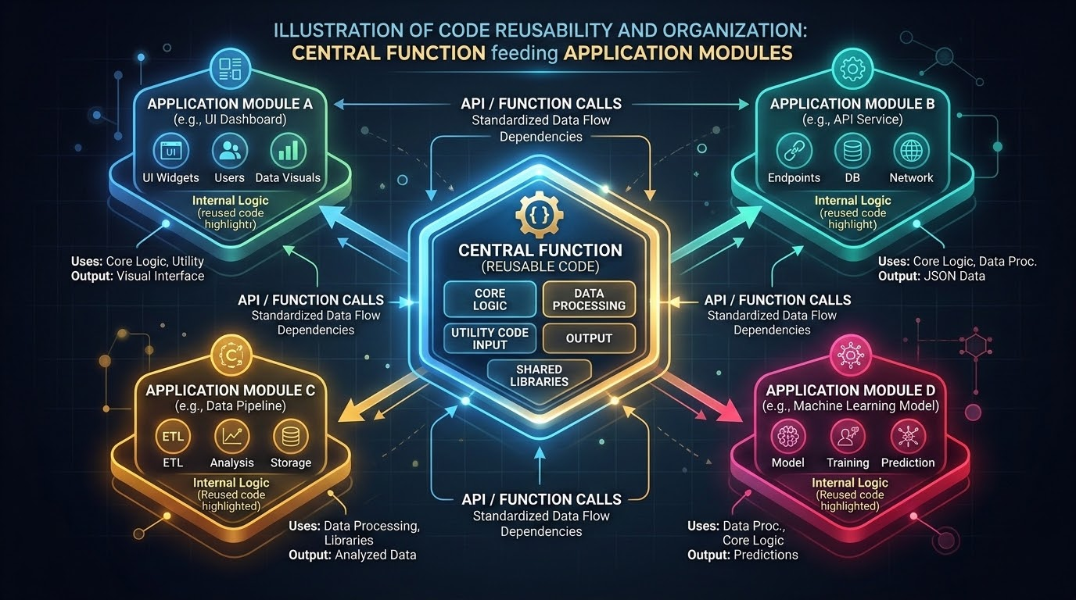
Why Use Functions?
Unlocking efficiency and maintainability in your code
Reusability: Write code once, use it multiple times across your application.
Organization: Break complex problems into smaller, manageable pieces.
Maintenance: Updating a function automatically updates its behavior everywhere it is used.
Reduced Duplication: Adhere to the DRY (Don't Repeat Yourself) principle.
Readability: Well-named functions make your main code read like plain English.
Debugging: Isolate errors to specific blocks of code easily.
Functions in Python | Building Reusable and Efficient Programs

Slide 5

Types of Functions in Python
Categorizing functions by their origin
Built-in Functions
User-Defined Functions
Functions that are pre-defined in Python and always available for use without importing any modules.
Functions created by the programmer to perform specific tasks tailored to the application's needs.
EXAMPLES
EXAMPLES
print(), len(), type(), max()
calculate_tax(), fetch_user_data(), greet_student()
Functions in Python | Building Reusable and Efficient Programs

Slide 6
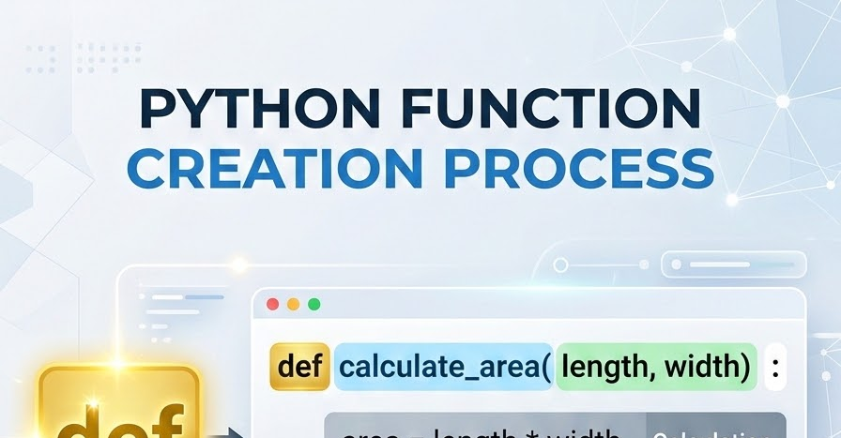
def function_name():
# Code block to execute
statement
Creating a Function
Defining behavior using the 'def' keyword
To create a function in Python, you use the def keyword, followed by the function name, parentheses (), and a colon :.
The code block within every function must be indented.
SYNTAX GUIDE
PRACTICAL EXAMPLE
def say_hello():
print("Hello, World!")
Functions in Python | Building Reusable and Efficient Programs

Slide 7

Calling a Function
Executing the defined block of code
Defining a function only tells Python what the function should do, but it does not execute the code. To run the function, you must 'call' it by writing its name followed by parentheses.
Definition
Execution (Calling)
def display_message():
print("Learning Python is fun!")
display_message() # This triggers the function
OUTPUT:
Learning Python is fun!
Functions in Python | Building Reusable and Efficient Programs

Slide 8

Function Components
Understanding the Anatomy of a Python Function
Keyword: The def keyword initiates the function definition.
CODE STRUCTURE ANATOMY
Name: A unique identifier used to call the function (e.g., calculate_total).
def add_numbers(a, b): # def, name, parameters
sum = a + b # body
return sum # return statement
Parameters: Optional variables listed inside the parentheses that accept input data.
Body: The indented block of code that performs the actual operations.
Functions provide a way to group code into reusable blocks. The structure above shows how inputs (parameters) are processed in the body and output via a return statement.
Return Statement: An optional statement that sends a result back to the caller.
Functions in Python | Building Reusable and Efficient Programs

Slide 9

Function Parameters
CORE CONCEPT
Passing data into your functions for dynamic behavior.
def greet(name):
print(f"Hello, {name}!")
greet("Ali") # Output: Hello, Ali!
greet("Sara") # Output: Hello, Sara!
Parameters are variables listed inside the parentheses in the function definition.
They allow you to pass information into a function so it can perform operations on different data each time it is called.
Here, name is the parameter, and "Ali" and "Sara" are the arguments passed during the call.
Functions in Python | Building Reusable and Efficient Programs

Slide 10
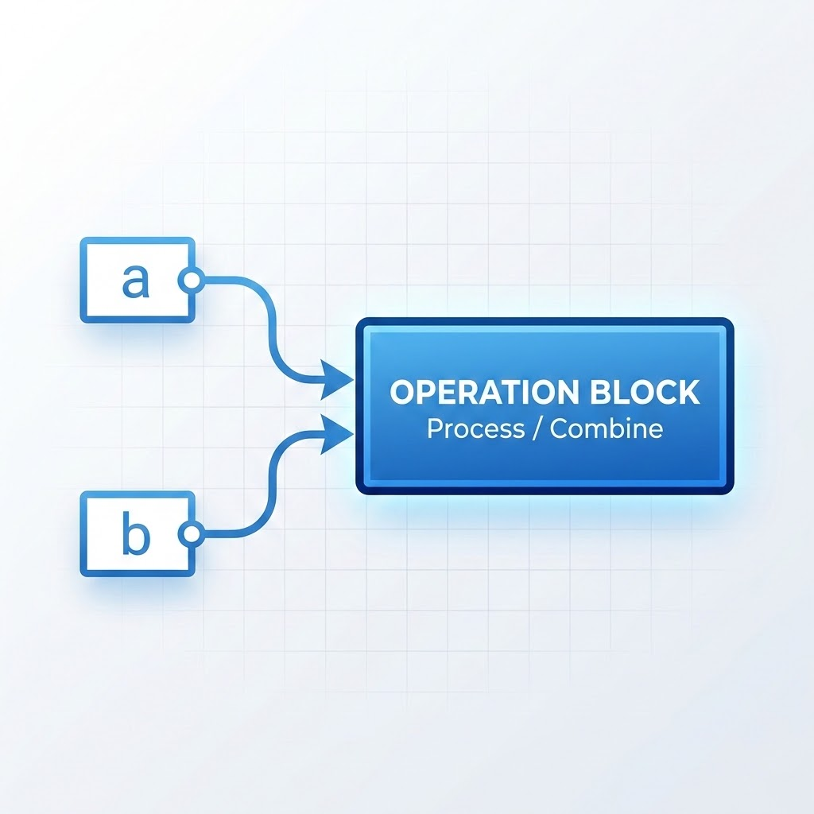
Multiple Parameters
Accepting multiple inputs for complex operations. Simply separate them with commas in the function definition.
FUNCTION DEFINITION
CALLING THE FUNCTION
def add(num1, num2):
result = num1 + num2
print(f"The sum is: {result}")
add(10, 20) # Output: The sum is: 30
add(5, 7) # Output: The sum is: 12
When calling the function, you must provide the exact number of arguments in the same order as the parameters.
Functions in Python | Building Reusable and Efficient Programs

Slide 11
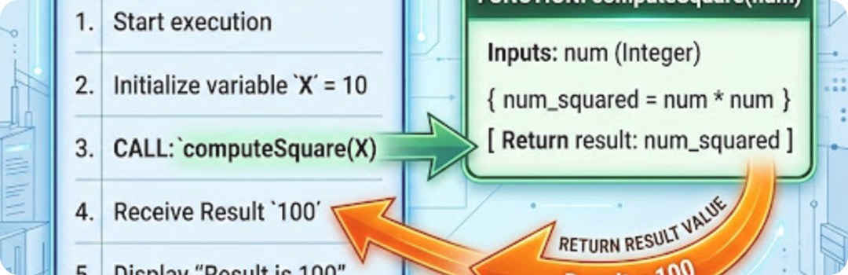
The Return Statement
Sending results back to the caller
PYTHON EXAMPLE
The return statement is used to exit a function and pass a calculated value back to the place where the function was called.
This allows you to store the result in a variable or use it in further calculations.
def square(number):
return number * number
result = square(5)
print(result) # Output: 25
BEHAVIOR
"Once a return statement is executed, the function terminates immediately."
Conceptual Flow: Function Return Value
Functions in Python | Building Reusable and Efficient Programs

Slide 12
Functions Without Return
Performing actions without outputting data
Not all functions need to return a value. Some exist purely to perform specific actions.
# Example of a void function
def display_status(status):
print(f"Current system status: {status}")
# Calling the function
display_status("Online")
Printing to the console or logs.
Modifying files or persistent data.
Updating a database or system state.
These are often referred to as "void" functions in programming literature.
The print() function itself is a void function—it displays text but returns None.
IMPLICIT RETURN VALUE
If a function does not have a return statement, it implicitly returns a special Python value called None.
Functions in Python | Building Reusable and Efficient Programs

Slide 13
Positional Arguments
Assigning values based on their order: Python assigns arguments to parameters based on their position in the function call. The first argument maps to the first parameter, and so on.
def student(name, age):
print(f"Student {name} is {age} years old.")
CORRECT
INCORRECT
student("Ahmed", 20)
# Output:
Student Ahmed is 20 years old.
student(20, "Ahmed")
# Output (Logic Error):
Student 20 is Ahmed years old.
Introduction of Electronics | Robotics and Automation Systems

Slide 14
Keyword Arguments
Specifying values by parameter names
You can explicitly state which parameter an argument belongs to by using the parameter name in the function call. This is called a keyword argument.
Key Advantage:
When using keyword arguments, the order does not matter. This improves readability and prevents ordering mistakes.
CODE EXAMPLE
def student(name, age):
# Print student info
print(f"Student {name} is {age} years old.")
# Order doesn't matter
student(age=20, name="Ahmed")
# Output:
"Student Ahmed is 20 years old."
Functions in Python | Building Reusable and Efficient Programs

Slide 15

Default Parameters
Setting fallback values for missing arguments
You can assign a default value to a parameter in the function definition. If the caller does not provide an argument, Python will use the default.
Ensures functions remain functional even with incomplete inputs.
Note: Parameters with default values must come after parameters without default values.
# Function with default
def greet(name="Guest"):
print(f"Hello, {name}!")
# Case 1: Caller provides argument
greet("Ali")
# Output: Hello, Ali!
# Case 2: Caller omits argument
greet()
# Output: Hello, Guest!
Think of default values as a "safety net" (like the bridge net shown) that catches the execution when specific data is missing.
Functions in Python | Building Reusable and Efficient Programs

Slide 16

Arbitrary Arguments (*args)
Handling an unknown number of positional arguments
CODE EXAMPLE
def calculate_total(*numbers):
total = 0
for num in numbers:
total += num
return total
# Output: 30
print(calculate_total(10, 20))
# Output: 100
print(calculate_total(10, 20, 30, 40))
If you do not know how many arguments will be passed into your function, add an asterisk * before the parameter name.
This gathers all positional arguments into a tuple.
FLEXIBILITY
The function treats the arguments as a single sequence, allowing for dynamic call lengths without defining multiple parameters.
Functions in Python | Building Reusable and Efficient Programs

Slide 17

Keyword Arbitrary Arguments (**kwargs)
HANDLING UNKNOWN KEYWORD ARGUMENTS
Add two asterisks ** before the parameter name to gather keyword arguments into a dictionary.
PYTHON EXAMPLE
Dictionary Transformation
def student_info(**info):
for key, value in info.items():
print(f"{key}: {value}")
# Function Call
student_info(name="Ali", age=20, major="CS")
'name': "Ali"
'age': 20
'major': "CS"
Functions in Python | Building Reusable and Efficient Programs

Slide 18
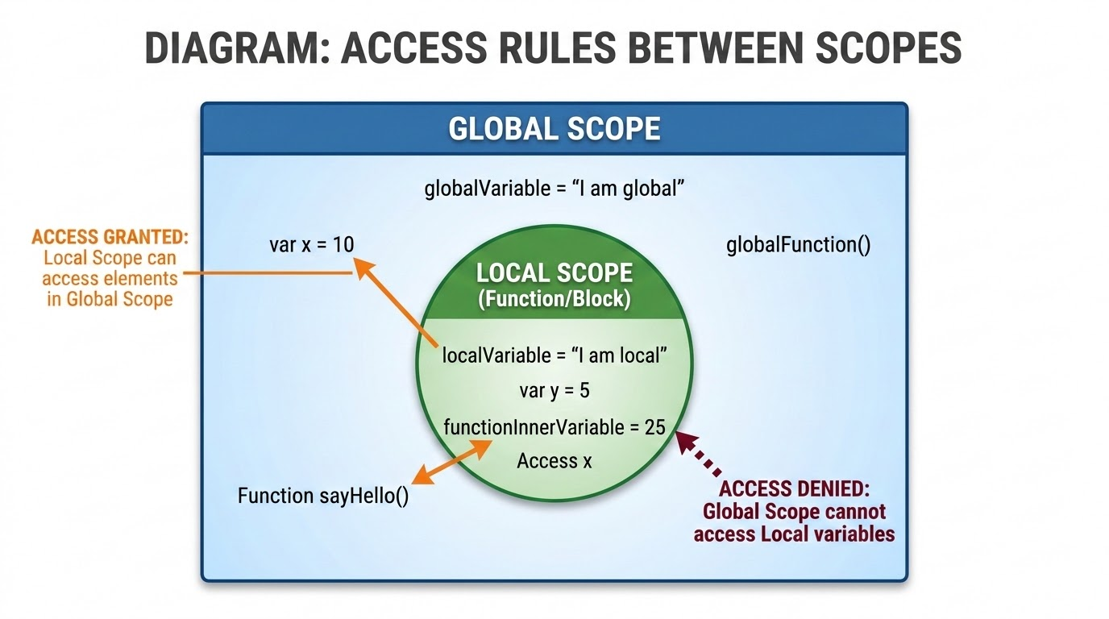
Variable Scope
Understanding where variables can be accessed
Scope refers to the region of the code where a variable is recognized and can be accessed. Python has two primary variable scopes:
Local Scope
Variables created inside a function. They can only be used within that specific function and are destroyed when the function finishes.
Global Scope
Variables created outside of any function. They can be accessed and read by any function in the entire script.
SCOPE HIERARCHY VISUALIZATION
Introduction of Electronics | Robotics and Automation Systems

Slide 19

Local Variables
DATA ISOLATION
PYTHON EXAMPLE
Data isolated within a specific function
visibility_off
def my_function():
message = "I am local!" # Local variable
print(message)
my_function() # Prints: I am local!
# print(message)
# This would cause an error because 'message'
# does not exist outside the function.
A variable declared inside a function's body is a local variable. It is completely hidden from the rest of the program.
Scope Isolation: The "Locked Box" Principle
Functions in Python | Building Reusable and Efficient Programs

Slide 20

Global Variables
Data accessible throughout the entire script
PYTHON EXAMPLE
A variable declared outside of any function is considered global.
# Global variable
counter = 0
def increment():
global counter # Required to modify
counter += 1
print(counter)
increment() # Output: 1
increment() # Output: 2
Any function can read a global variable, but modifying it requires the global keyword.
Without the global keyword, Python treats variables inside functions as local by default when assigning values.
Functions in Python | Building Reusable and Efficient Programs

Slide 21

Recursive Functions
Functions that call themselves
def countdown(n):
if n <= 0: # Base case
print("Blastoff!")
else:
print(n)
countdown(n - 1) # Recursive call
countdown(3)
# Output: 3, 2, 1, Blastoff!
Recursion occurs when a function calls itself to solve a smaller instance of the same problem.
It must have a base case to stop the recursion and prevent an infinite loop.
BASE CASE
The condition that terminates the recursive process. In the example, n <= 0 acts as the anchor.
VISUAL ANALOGY: RECURSION
Functions in Python | Building Reusable and Efficient Programs

Slide 22

Introduction to Lambda Functions
Small, anonymous, inline functions
A lambda function is a small anonymous function defined using the lambda keyword instead of def. They can take any number of arguments but can only have one expression.
Syntax
lambda arguments : expression
Characteristics
[Bullet Point]
Anonymous: They do not require a name.
[Bullet Point]
Single Expression: The body can only contain one evaluated expression, not a block of statements.
[Bullet Point]
Implicit Return: The result of the expression is automatically returned.
Fast Execution & Functional Programming
Functions in Python | Building Reusable and Efficient Programs

Slide 23

Creating Lambda Functions
Lambda functions are often used when you need a simple function for a short period of time.
Traditional Function
Lambda Equivalent
def square(x):
return x * x
print(square(5)) # Output: 25
square_lambda = lambda x: x * x
print(square_lambda(5)) # Output: 25
Analogy: Specialized Tool vs. Multi-purpose Utility
Introduction of Electronics | Robotics and Automation Systems

Slide 24
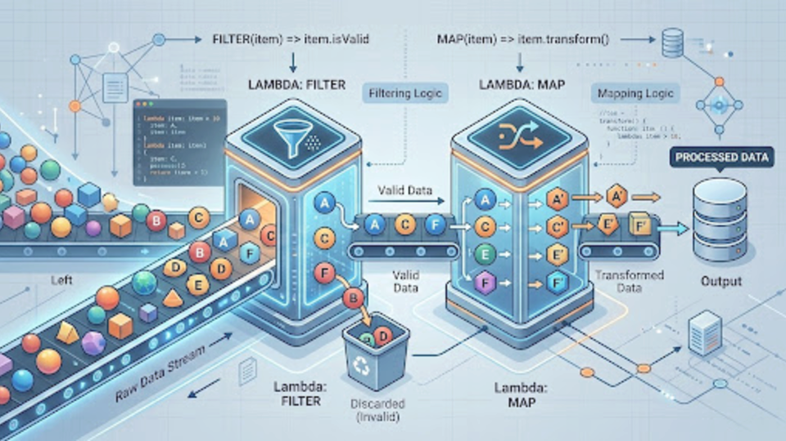
Lambda with Higher-Order Functions
Practical applications with map(), filter(), and sorted(). Lambda functions shine when used inside functions that take other functions as arguments.
USING FILTER() (KEEP EVEN NUMBERS)
USING MAP() (DOUBLE THE NUMBERS)
nums = [1, 2, 3, 4, 5, 6]
evens = list(filter(lambda x: x % 2 == 0, nums))
# evens is [2, 4, 6]
nums = [1, 2, 3, 4, 5, 6]
doubled = list(map(lambda x: x * 2, nums))
# doubled is [2, 4, 6, 8, 10, 12]
Functions in Python | Building Reusable and Efficient Programs

Slide 25
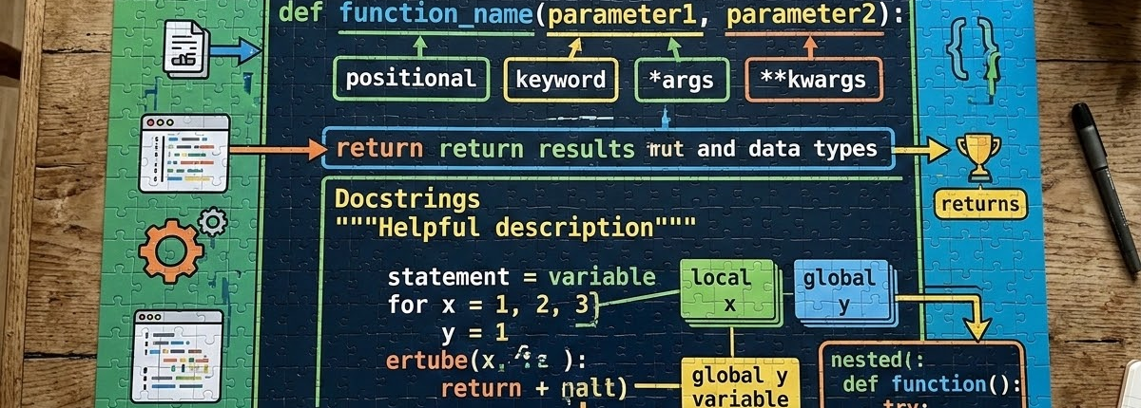
Summary & Key Takeaways
Core Concept: Functions are reusable blocks of code that improve organization and reduce duplication.
Creation: Defined using the def keyword, executed via function calls.
Data Flow: Use parameters to pass data in, and return statements to get data out.
Scope: Variables can be local (inside a function) or global (script-wide).
Flexibility: Python supports positional, keyword, default, and arbitrary arguments (*args, **kwargs).
Advanced: Recursion allows functions to call themselves, while lambdas provide quick, anonymous, single-expression functions.
Functions in Python | Building Reusable and Efficient Programs

